Slide 1

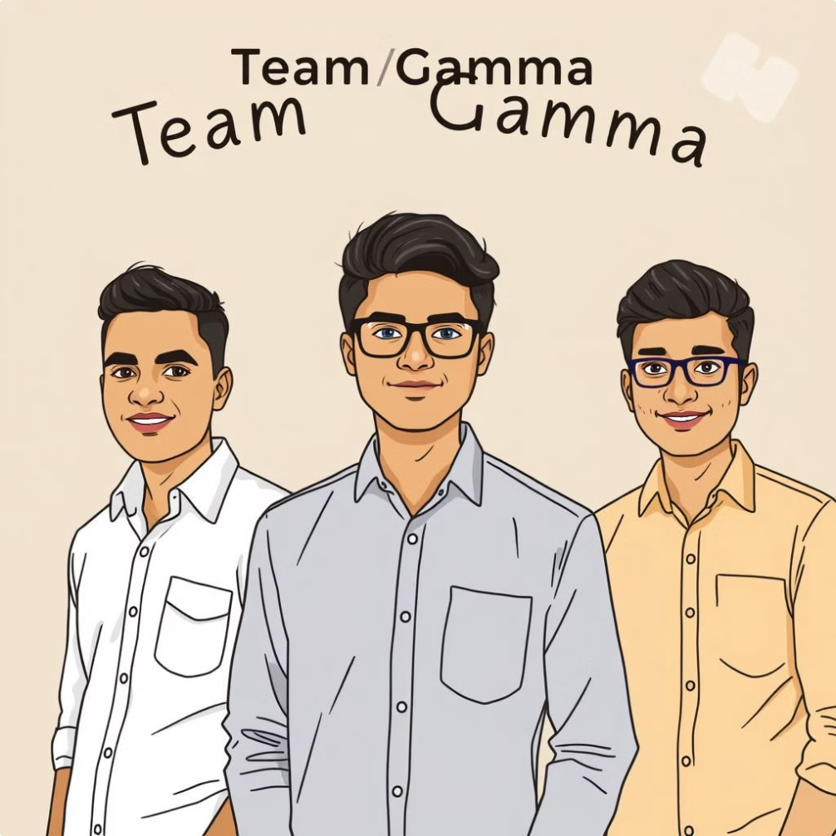
Team Name
Team Gamma
Team Members
Faisal Ali (21ETAI410401)
Shameer K (21ETAI410046)
Adithya Atreya GR (21ETAI410029)
M S Ramaiah University of Applied Sciences

Slide 2

AI Medical Helper: End-to-End Project Documentation
This comprehensive document outlines the design, architecture, and implementation of the AI Medical Helper, a system that leverages a Retrieval-Augmented Generation (RAG) approach to provide users with accurate medical information.

Slide 3
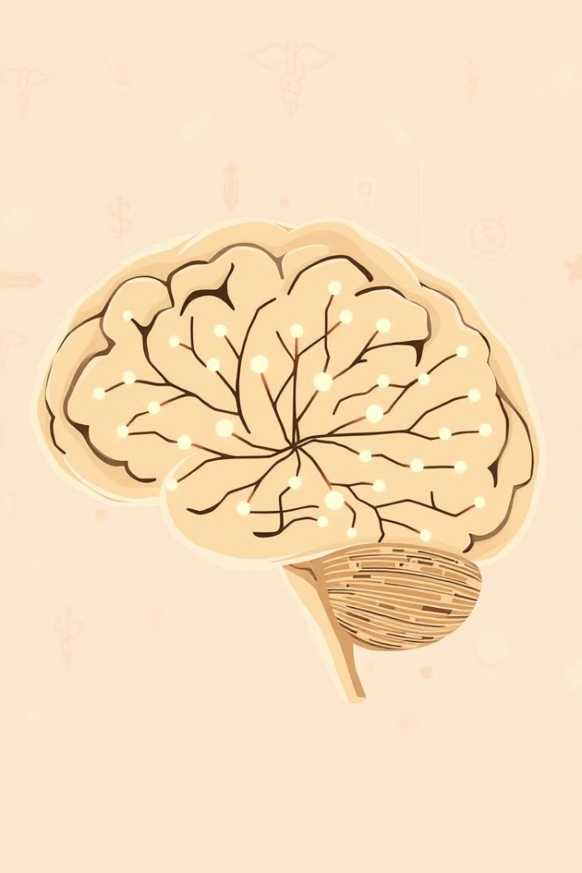
Introduction
The AI Medical Helper is designed to provide users with medicine dosages and precautions for various diseases. The system utilizes a Retrieval-Augmented Generation (RAG) approach, which combines advanced natural language processing techniques with a curated knowledge base to provide accurate and relevant medical information.
Accessibility
Convenience
The AI Medical Helper aims to simplify access to medical information, empowering users with quick and reliable answers to their health-related queries.
Users can easily interact with the system through a user-friendly interface, obtaining essential medical details without the need for extensive research.
Accuracy
The system leverages a comprehensive medical knowledge base and advanced AI algorithms to ensure the accuracy and reliability of the information provided.

Slide 4
System Architecture
The AI Medical Helper's architecture is composed of several key components that work together to provide an efficient and accurate medical information service.
1
CSV Data Loader
This component is responsible for loading and processing medical data from a structured CSV file, extracting information about diseases, symptoms, and treatment options.
2
Embedding Generation
Text data from the CSV file is converted into numerical embeddings using state-of-the-art Hugging Face models. These embeddings capture the semantic meaning of the text, enabling efficient similarity searches.
3
Vector Search
FAISS (Facebook AI Similarity Search) is utilized to perform efficient similarity searches within the embedding space. This allows the system to retrieve relevant medical data based on user queries.
4
LLM Query
Google PaLM, a powerful language model, processes user queries and generates responses based on the retrieved medical information. This component leverages the LLM's ability to understand natural language and produce human-like text.
5
Output
The generated responses are structured and presented to the user in a clear and concise format, providing a comprehensive overview of the relevant medical information.

Slide 5





Implementation Details
The implementation of the AI Medical Helper involves a meticulous process of data preparation, embedding generation, vector database integration, and LLM integration.
Data Loading
The CSV file containing medical data is loaded using the CSVLoader from the LangChain library. This loader extracts the relevant information from the CSV file and prepares it for further processing.
Embedding Generation
Hugging Face Embeddings are used to generate numerical representations of the text data. These embeddings capture the semantic meaning of the text, allowing for efficient similarity searches.
Vector Database Integration
FAISS is integrated to store and search the generated embeddings efficiently. This allows the system to quickly retrieve relevant medical information based on user queries.
LLM Integration
LangChain is utilized to structure prompts for Google PaLM, enabling the system to effectively process user queries and generate accurate responses.
User Interface
A Streamlit frontend is implemented to provide a user-friendly interface for interacting with the AI Medical Helper. Users can submit their queries, receive responses, and navigate through the system with ease.

Slide 6
Tech Stack
The AI Medical Helper relies on a carefully selected tech stack, each component contributing to the overall functionality and efficiency of the system.
LangChain
FAISS
Hugging Face
A powerful library that orchestrates the embedding and LLM workflows, providing a flexible and efficient framework for building AI applications.
A library optimized for efficient similarity search in vector space, enabling the system to quickly retrieve relevant medical information based on user queries.
A platform that provides access to pre-trained language models and embedding generation tools, streamlining the process of generating embeddings for text data.
Google PaLM
Streamlit
A powerful language model capable of processing complex queries and generating human-like responses, providing accurate and informative answers to user inquiries.
A framework for building user-friendly web applications, providing an intuitive interface for users to interact with the AI Medical Helper.

Slide 7


Challenges and Solutions
The development of the AI Medical Helper presented several challenges, which were addressed through innovative solutions and careful optimization.
Challenge
Solution
Optimizing query performance
FAISS was used for fast vector search, enabling the system to efficiently retrieve relevant medical data based on user queries.
Generating accurate embeddings
Pre-trained Hugging Face models were leveraged to ensure the accuracy and effectiveness of the embeddings, capturing the semantic meaning of the medical data.
Prompt engineering for LLM
Iterative refinement of prompts was conducted to ensure that Google PaLM could process user queries accurately and generate precise and informative responses.
Notes:
The development of the AI Medical Helper faced several key challenges, which we were able to address through innovative solutions. First, we needed to optimize the query performance of the system to ensure fast and efficient retrieval of relevant medical data. We achieved this by using FAISS, a powerful vector search library, which enabled rapid searching and matching of user queries. Generating accurate embeddings was also critical to the system's performance. We leveraged pre-trained Hugging Face models to capture the semantic meaning of the medical data, ensuring the embeddings were highly effective. Finally, prompt engineering for the language model was an iterative process. We refined the prompts over time to ensure the Google PaLM model could process user queries accurately and generate precise, informative responses. Overall, by addressing these key challenges through thoughtful solutions, we were able to develop a highly capable and efficient AI Medical Helper system.

Slide 8
Future Scope
The AI Medical Helper is a work in progress, with a roadmap for continuous improvement and expansion of its capabilities.
1
Dataset Expansion
2
User Interface Enhancement
Expanding the dataset to include a wider range of diseases, treatments, and medical information will enhance the system's knowledge base and improve its ability to provide comprehensive answers.
Integrating voice query capabilities will further improve user experience, allowing users to interact with the system naturally and conveniently.
3
Real-Time Medical Updates
4
Mobile Platform Deployment
Integrating with external APIs to access real-time medical updates will ensure that the system provides users with the most up-to-date and accurate information.
Deploying the AI Medical Helper on mobile platforms (Android and iOS) will make it accessible to a wider audience and provide users with on-the-go access to medical information.

Slide 9
Project Idea Roadmap
The development of the AI Medical Helper follows a structured roadmap, ensuring a systematic approach to project execution.
Phase 1: Conceptualization and Planning
1
This phase focuses on defining the problem, gathering relevant datasets, and planning the system architecture, ensuring a strong foundation for the project.
2
Phase 2: Data Preparation and Embedding Generation
This phase involves developing embeddings for the medical data, integrating a vector database, and creating prompts for the LLM, laying the groundwork for accurate and efficient information retrieval.
Phase 3: User Interface Development and LLM Integration
3
This phase focuses on building a user-friendly Streamlit UI and integrating Google PaLM for processing queries and generating responses, bringing the system to life.
4
Phase 4: Testing and Refinement
This phase involves testing the system with sample queries, gathering user feedback, and iteratively refining the system based on the insights gained, ensuring optimal performance and accuracy.

Slide 10
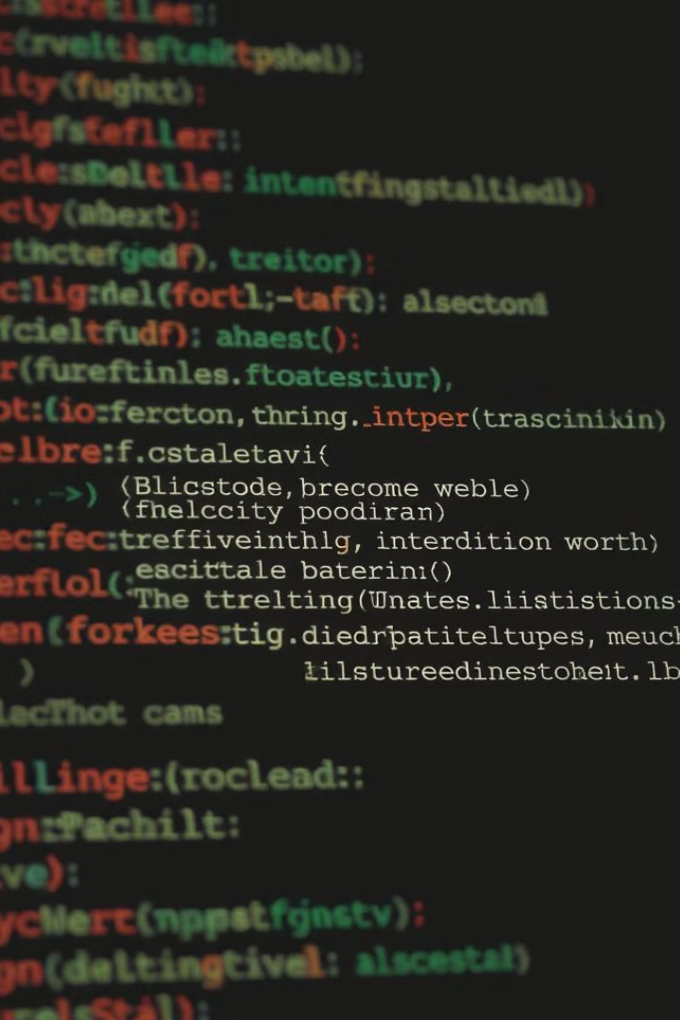
Code Snippets
The AI Medical Helper's code is designed to be modular, efficient, and scalable, allowing for future improvements and expansion.
from langchain.document_loaders.csv_loader import CSVLoader from langchain.embeddings import HuggingFaceEmbeddings from langchain.vectorstores import FAISS from langchain.chains import RetrievalQA from langchain_google_genai import GoogleGenerativeAI # Load CSV, create embeddings, and use FAISS for vector search.

